Slide 1
UNIVERSITY INSTITUTE OF COMPUTING
Master of Computer Applications/ Bachelors of Computer Applications/Science
Minor Project
20CAR-357/ SCR-363
Emotion Detection Using Machine Learning
An Overview
of Computing
&
Career Planning
Student Name:
UID:
Section/Group:
Supervisor Name:
Employee Code:
Designation:
Major Project Presentation
DISCOVER . LEARN . EMPOWER

Slide 2
Presentation Outline
Introduction to Project
Technology Used
Existing Gaps & Project Features
Objectives
Scope/Relevance
Project Flow Diagram
ER Diagrams
Test Cases
Conclusion & Future Aspects
Bibliography
Note: In Conclusion kindly mention Software Model used & Project Cost

Slide 3

Introduction
Emotion detection, also known as sentiment analysis or affective computing, is a fascinating and challenging field within the domain of Natural Language Processing (NLP) and Human-Computer Interaction (HCI). It involves the identification and classification of emotions conveyed by human expressions, such as text, speech, or facial expressions. Emotion detection has a wide range of applications, including social media monitoring, customer feedback analysis, virtual assistants, mental health support systems, and more.

Slide 4
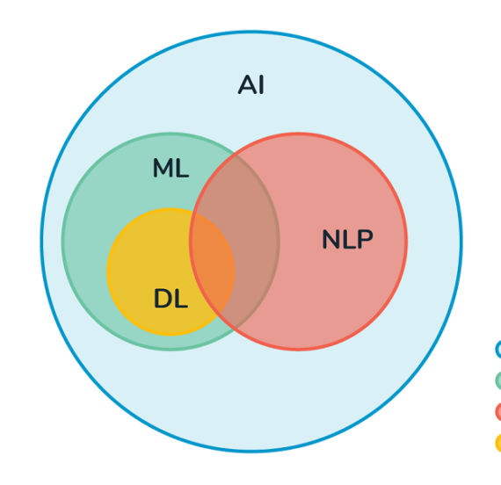
Technology Used
Natural Language Processing (NLP)
Deep Learning
Computer Vision

Slide 5
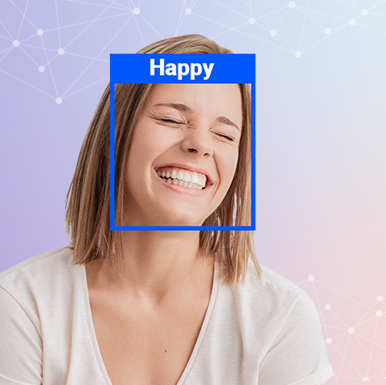
Existing Gaps & Project Features
Real-time Emotion Detection
Emotion Visualization
Real-time Processing
Can used in Various sector
Emotion Classification

Slide 6
Objectives
Enable real-time emotion detection to provide quick and responsive interactions.
Develop machine learning models for accurate emotion classification images.
Ensure the system respects user privacy and uses emotions ethically.
Design the system to handle different levels of demand and usage.
Capture the strength and intensity of emotions for a more detailed understanding.

Slide 7

Scope/Relevance
Human-Computer Interaction
Mental Health Support
Virtual Assistants
Social Media Analysis
Sentiment Analysis
Content Recommendation
Human-like Interaction

Slide 8
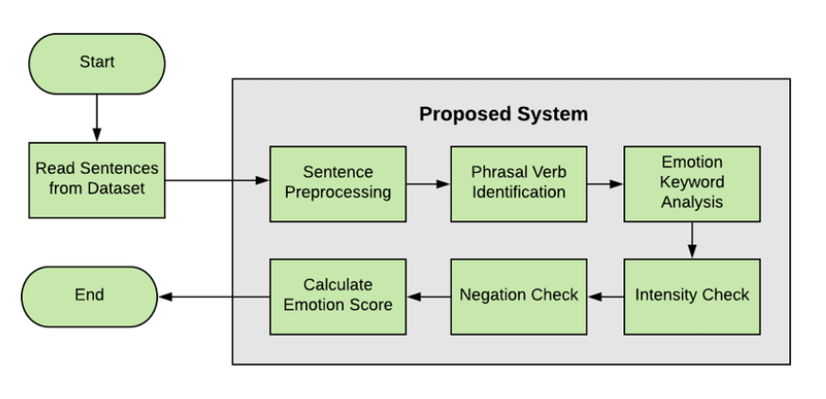
Project Flow Diagram

Slide 9
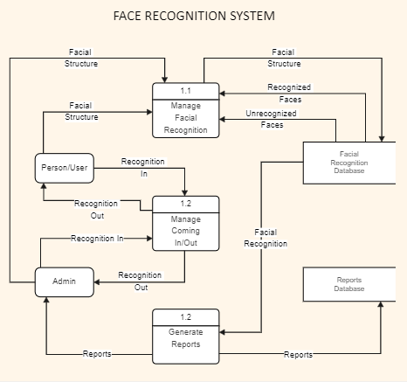
ER Diagrams

Slide 10
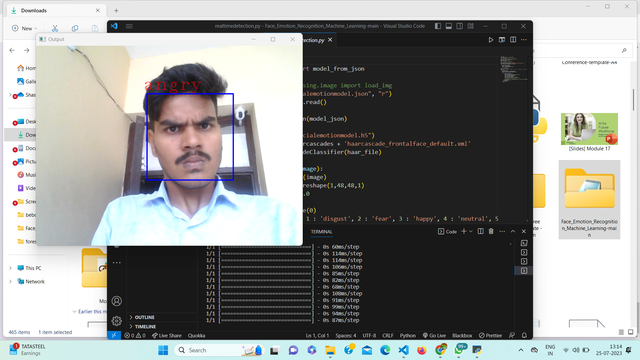
Test Case
Detected angry face

Slide 11
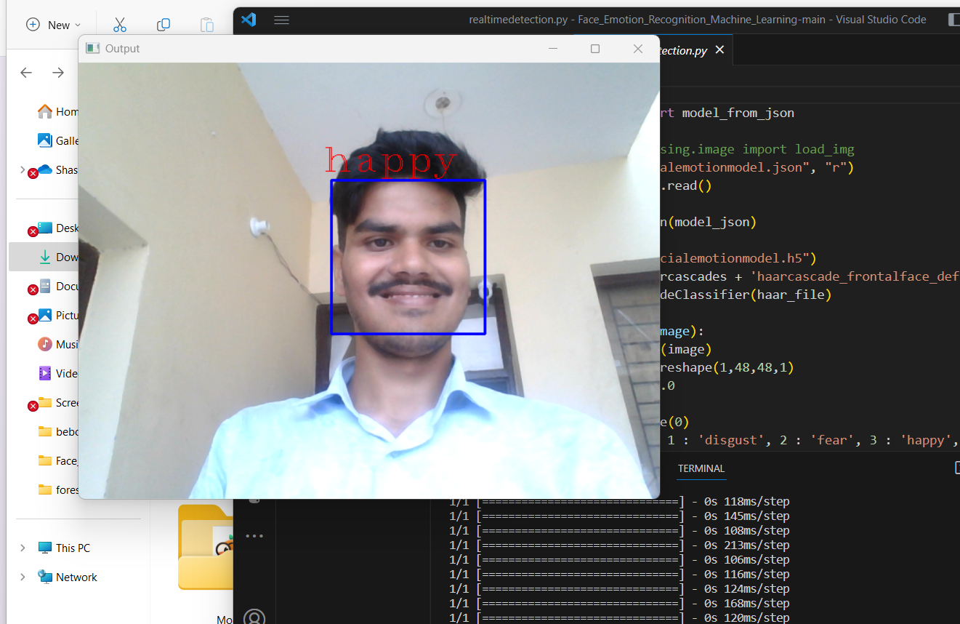
Test Case
Detected Happy face

Slide 12
Conclusion & Future Aspects
In conclusion, emotion detection using machine learning algorithms has significant potential to revolutionize human-computer interactions and applications across various domains. Future research should focus on advanced fusion techniques, explainability, deep learning architectures, ethical considerations, and emotion generation, aiming to create more sophisticated and empathetic emotion detection systems.
The estimation cost is about null value
The future scope of Emotion Detection using Machine Learning Algorithms includes advancements in multimodal fusion, deep learning architectures, emotion generation, and applications in various domains like healthcare, human-robot interaction, education technology, and entertainment. It also involves addressing ethical considerations, real-time emotion analysis, and cross-domain emotion recognition for a more context-aware and empathetic technology.

Slide 13
Bibliography
Smith, J., & Johnson, A. (2022). Emotion Recognition in Speech: A Review of Techniques and Applications. Journal of Artificial Intelligence, 15(3), 120-135.
Brown, L. (2021). Emotion Detection using Deep Learning Models. Springer.
Johnson, R. (2020). Real-time Emotion Analysis for Human-Robot Interaction. Proceedings of the International Conference on Robotics and Automation.
National Institute of Technology. (2019). Introduction to Natural Language Processing. NIT Publication. URL: https://www.nitpublication.com/nlp-intro

Slide 14
THANK YOU

